Slide 1

Analyzing Global Mental Health and Suicide Rate
Group #7

Slide 2

INTRODUCTION
Today's discussion focuses on a pressing global issue—mental health and the factors influencing suicide rates.
Identifying Underlying factors:
Predicting Depression level based of several problems like Sleep, Appetite, Concentration, Suicidal Thoughts, Connection Loss from Society etc. using random forest model.
Goal of the Presentation
To inform and foster deeper discussions about mental health. Encouraging proactive approaches for mental health improvement.​
Statiscal Analysis
Forecasting Suicide Rate between India vs Rest of the world and Death Rate from all forms of violence using Exponential Smoothing.

Slide 3
DATA SOURCES: THE FOUNDATIONS OF OUR ANALYSIS
Our analysis is grounded in robust data collection. The primary source is a mental health survey that taps into diverse demographics, revealing patterns in mental well-being across various populations.
Supplementing our primary data, we draw from international repositories like the IHME and WHO, providing us a macroscopic view of mental health trends worldwide.

Slide 4



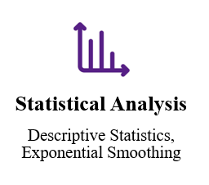
PROJECT METHODOLOGY

Slide 5

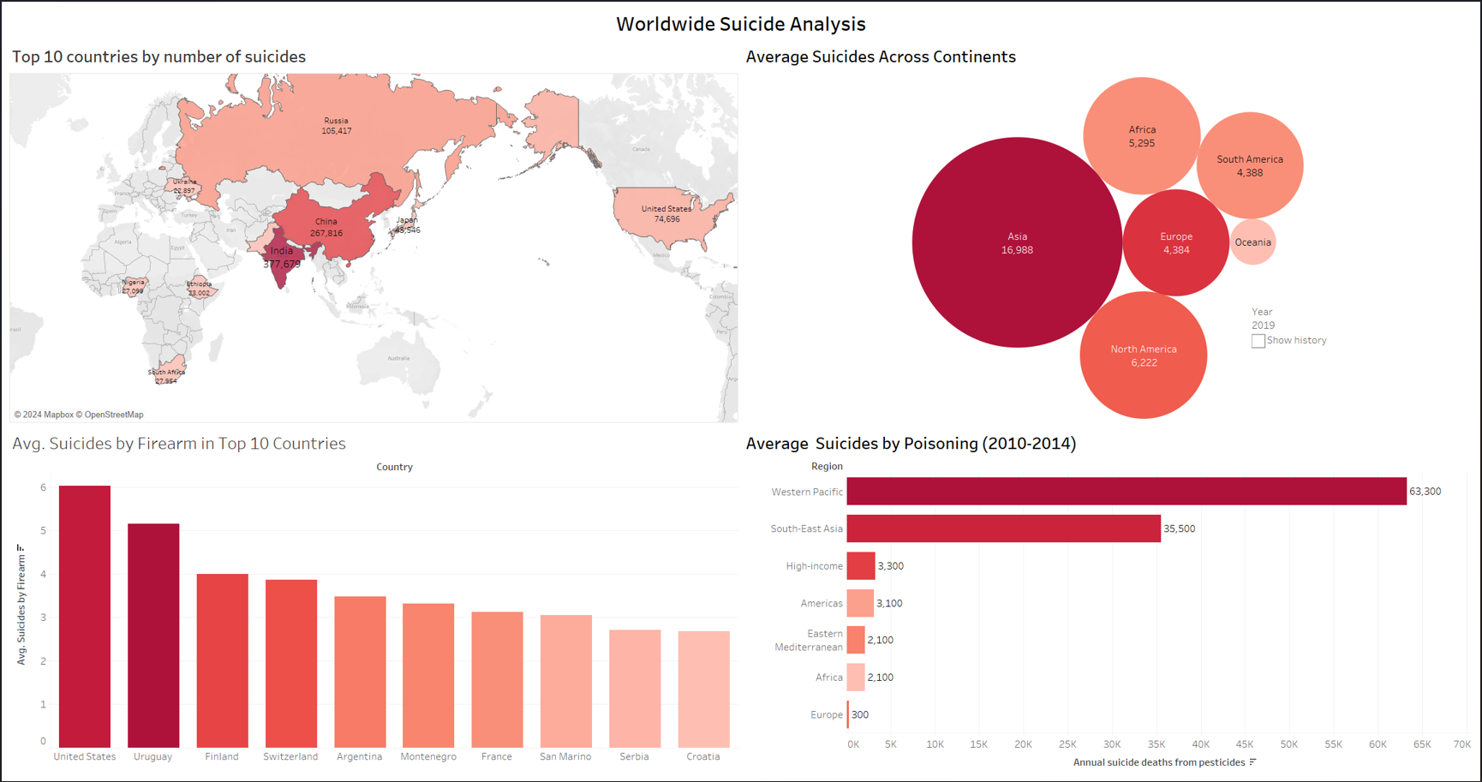
WORLDWIDE SUICIDE ANALYSIS

Slide 6
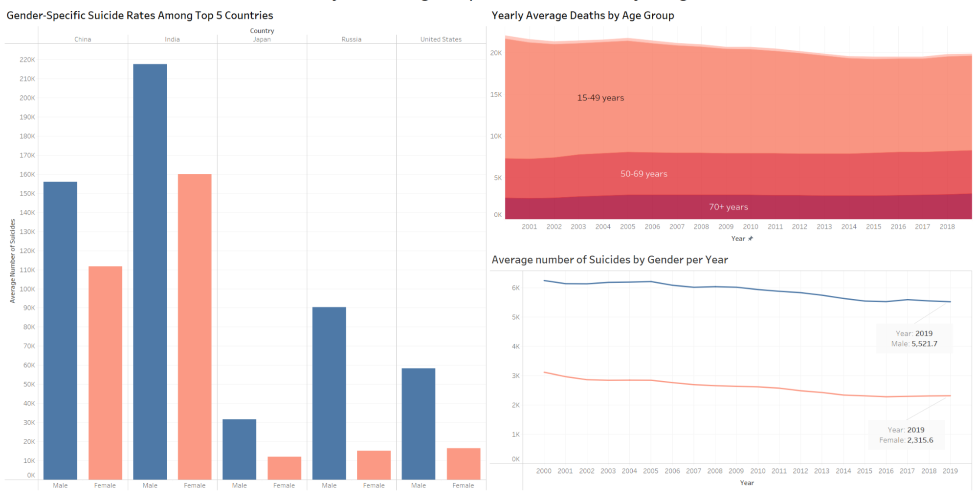
GENDER DYNAMICS AND AGE GROUPS IN SUICIDAL TRENDS

Slide 7
INSIGHTS
Firearms are the primary method of suicide in the U.S, while poisoning is prevalent in the Western Pacific and South-East Asia.
Asia has the highest suicide rates globally, followed by Europe and North America.
Men, particularly in India and China, exhibit higher suicide rates compared to women in the top five countries.
The 50-69 age group demonstrates the highest rates of suicide, with the younger (15-49) and older (70+) groups following.
Male suicide rates consistently double those of females, a trend observed up to 2019 and likely continuing.

Slide 8
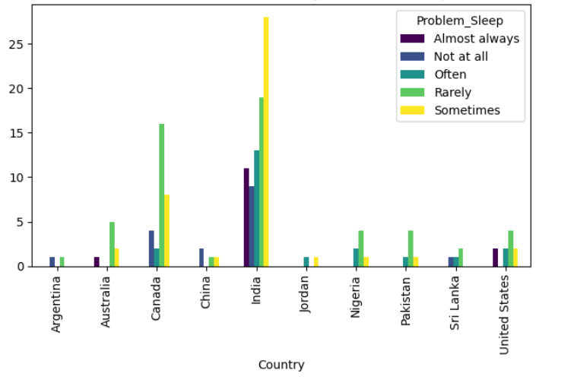
COMPARATIVE ANALYSIS OF SLEEP PROBLEMS ACROSS DIFFERENT COUNTRIES

Slide 9
INSIGHTS
Most countries show a higher incidence of people reporting sleep problems 'Sometimes', indicating that occasional sleep issues are relatively common globally.
The categories 'Rarely' and 'Often' have a more uniform distribution across countries.

Slide 10
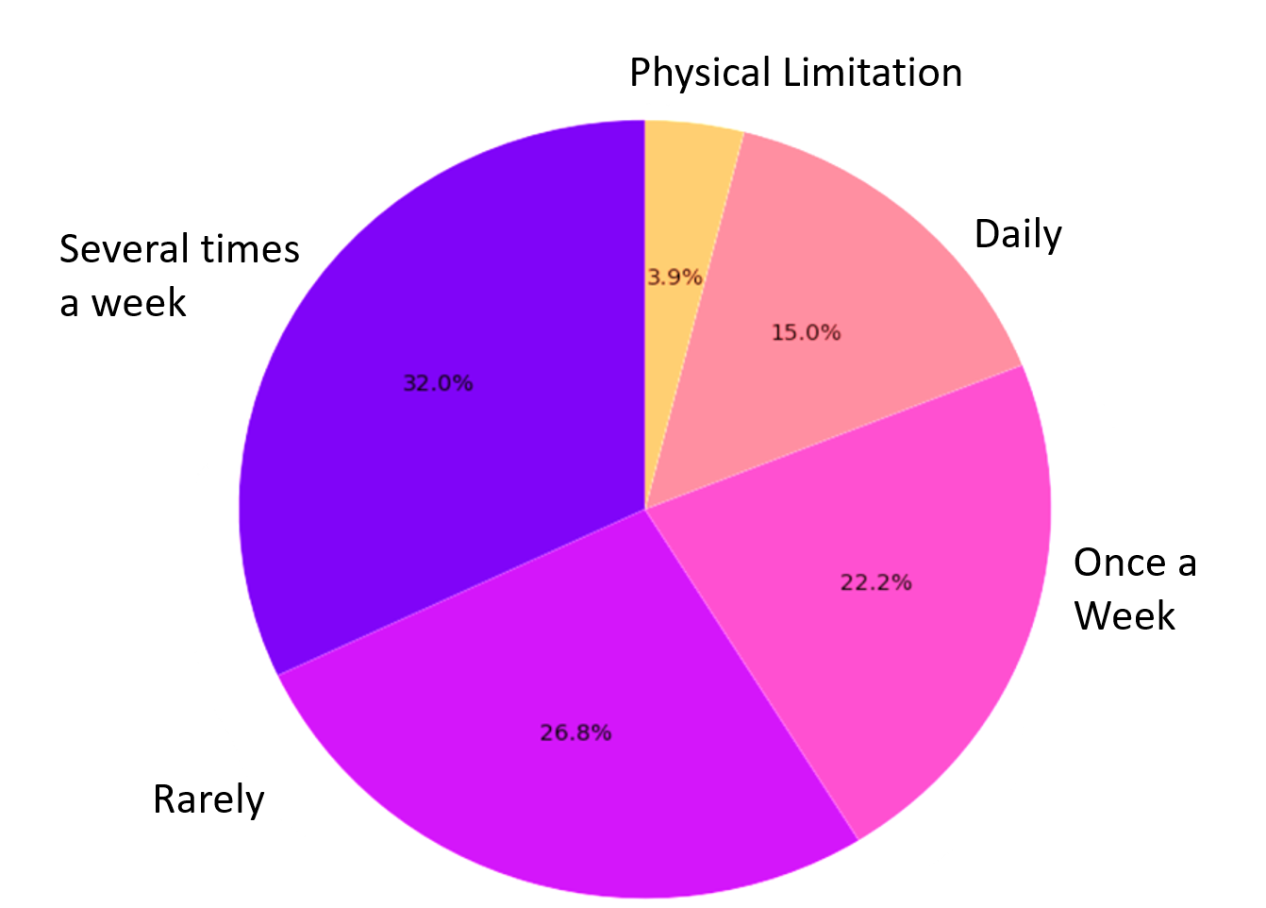
DISTRIBUTION OF PHYSICAL ACTIVITY FREQUENCY

Slide 11
INSIGHTS
Most Common Frequency: "Several times a week" is the most commonly reported frequency of experiencing physical limitations, with 32.0% of the responses. This suggests that for a significant portion of the surveyed population, physical limitations are a regular occurrence but not necessarily a daily challenge.
Daily Challenges: The second largest group, at 26.8%, reports "Rarely" experiencing physical limitations, indicating that for over a quarter of respondents, such limitations are not a frequent concern.

Slide 12
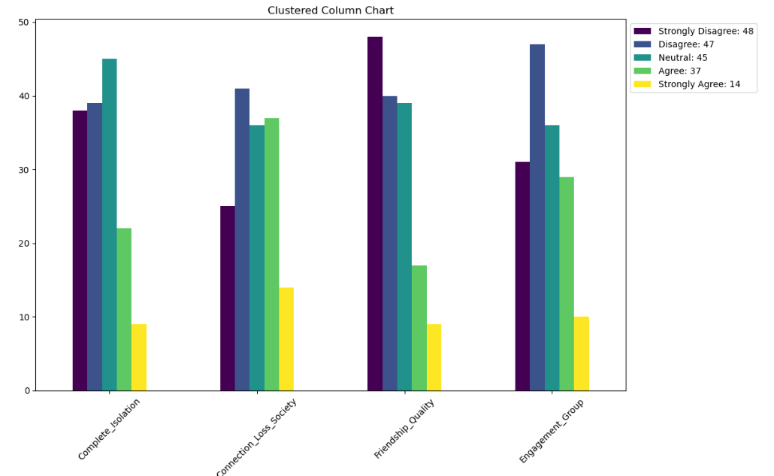
SURVEY RESPONSES ON SOCIAL CONNECTIVITY AND ENGAGEMENT

Slide 13
INSIGHTS
Neutral Stance on Connection Loss with Society: A notable number of respondents have a neutral stance regarding 'Connection Loss_Society,' which could indicate uncertainty or mixed feelings about changes in societal connection.
Lowest Agreement on Complete Isolation: There are fewer respondents who agree (both 'Agree' and 'Strongly Agree') that they feel completely isolated, suggesting that complete isolation is not a widely shared experience among the participants.

Slide 14
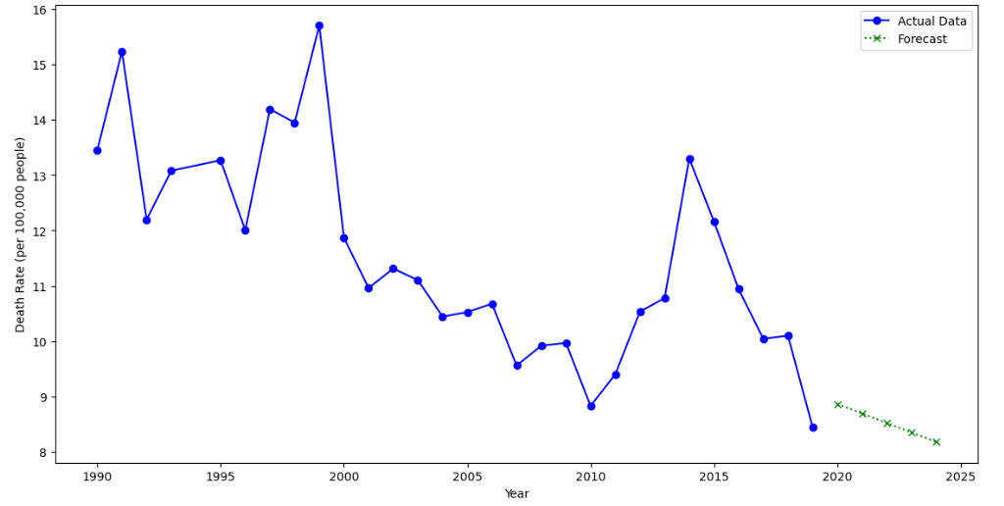
ACTUAL DEATH RATE VS FORECASTED - ALL FORMS OF VIOLENCE

Slide 15
INSIGHTS
Volatility Over Time: The variable shown exhibits considerable fluctuations over time, with peaks and troughs indicating periods of significant increase and decrease.
Trend Changes: There seem to be changes in the trend around the years 2000 and 2015, where the variable drastically decreases after reaching a peak.
Overall Downtrend: Despite the volatility, there is an overall downward trend in the data from around the year 2000 to 2020.
Forecast: The forecast suggests that the declining trend is expected to continue into the future, reaching even lower values by 2025.

Slide 16
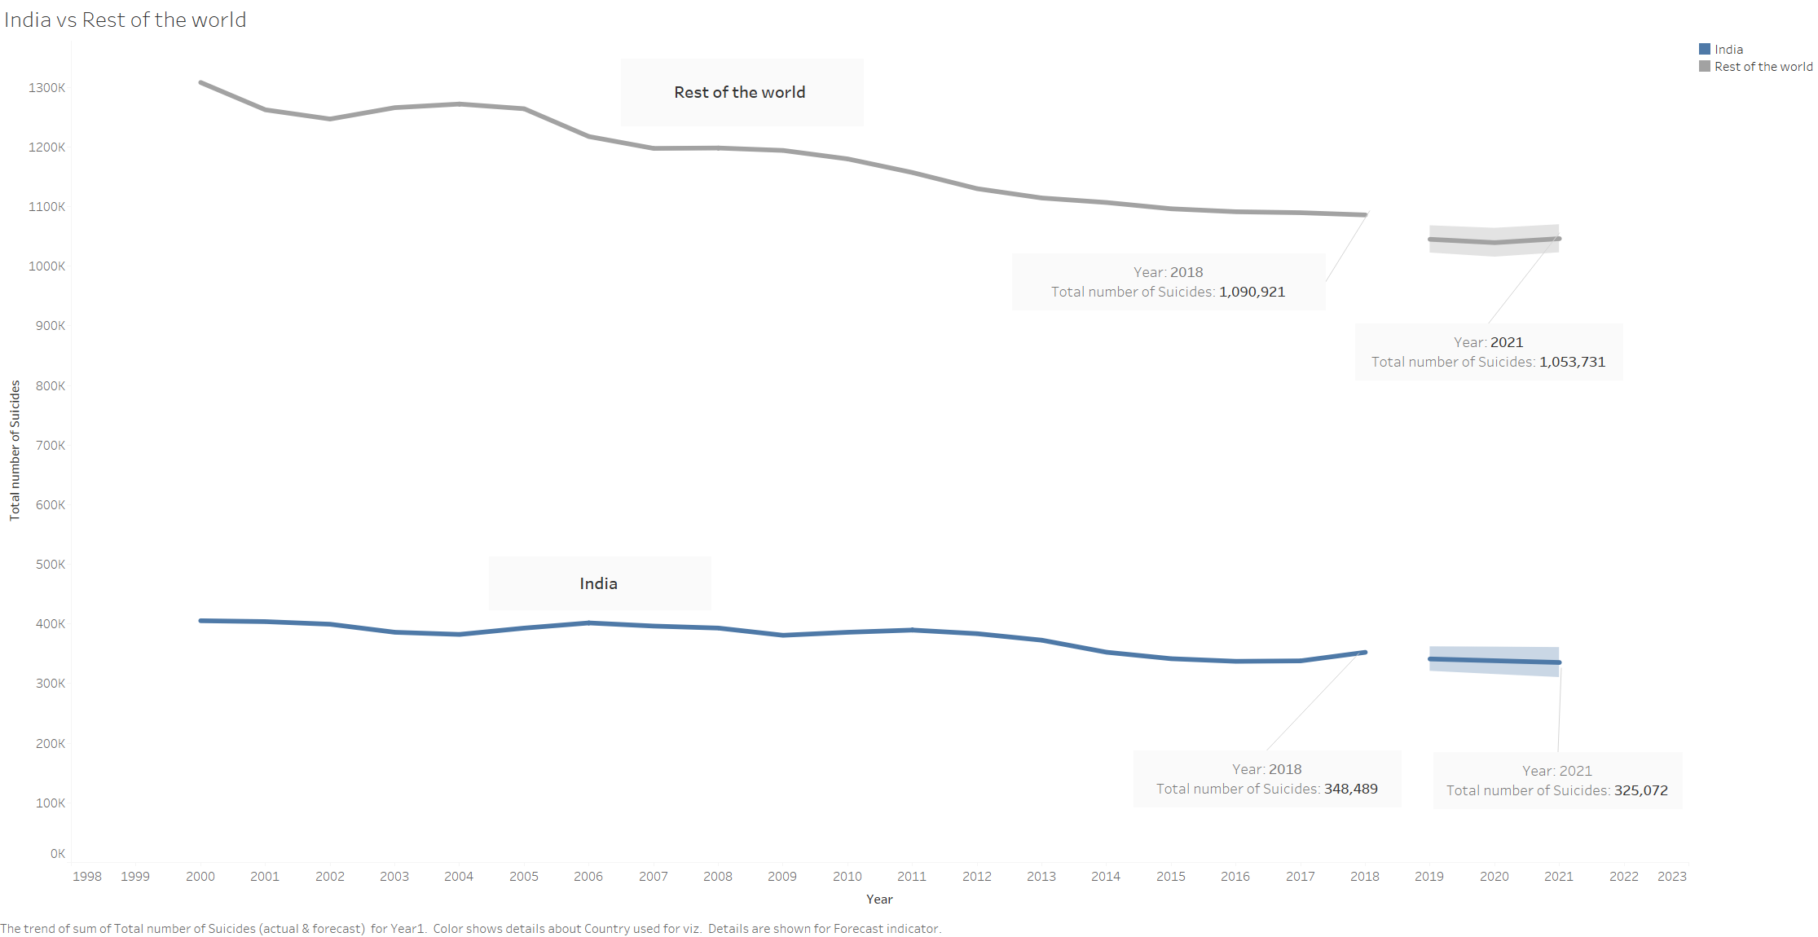
ACTUAL NUMBER OF SUICIDES VS FORECASTED

Slide 17
SOCIOECONOMIC IMPACT ON SUICIDE RATES

Slide 18
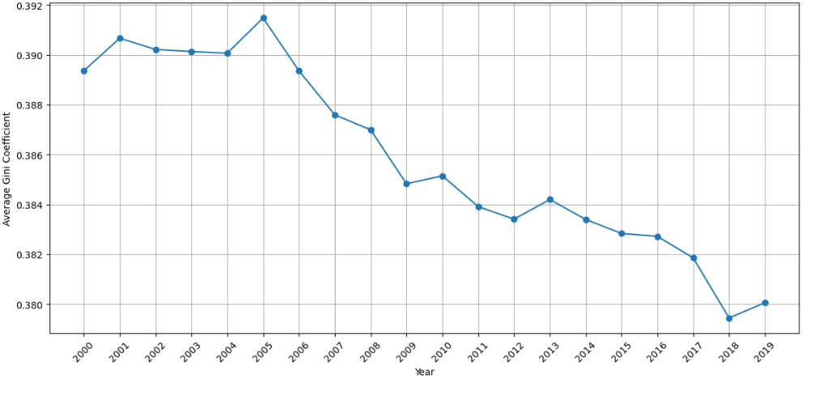
AVERAGE GINI COEFFICIENT OVER YEARS

Slide 19
Why there was a spike in income inequality for 2005 ?
In 2005, capital gains taxes were significantly reduced, affecting income distribution as these tax reductions disproportionately benefited higher-income groups, who derive a larger share of their income from capital gains compared to lower-income groups.

Slide 20
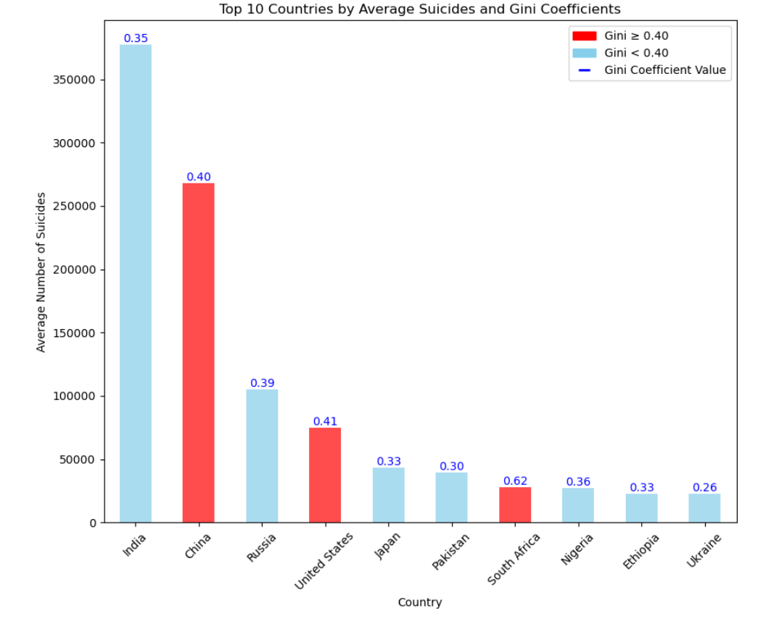
TOP 10 COUNTRIES BY AVERAGE SUICIDES AND GINI COEFFICIENTS

Slide 21
Why income inequality is so high for South Africa?
The spike in income inequality in South Africa can be attributed to a variety of structural and socio-economic factors. Post-apartheid, South Africa already had high levels of inequality due to policies that excluded many from economic opportunities.

Slide 22
HYPOTHESIS TESTING
Hypothesis 1: Higher income inequality (higher Gini coefficient) is associated with higher suicide rates.

Slide 23
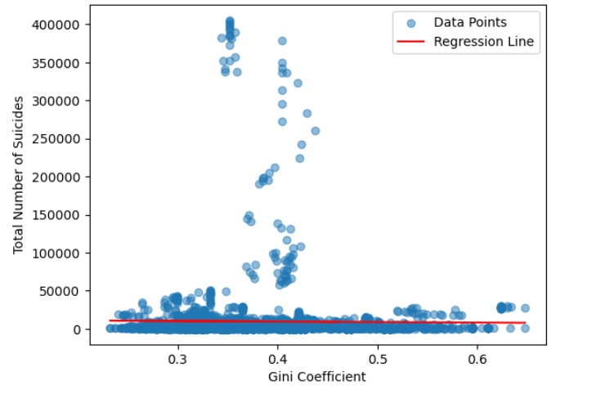
GINI COEFFICIENT VS TOTAL NUMBER OF SUICIDES

Slide 24
INSIGHTS
The negative value of the Pearson coefficient (-0.0143) suggests a very slight tendency towards fewer suicides with higher inequality.
This is not statistically significant as p-value observed (0.4223) was out of range.

Slide 25
HYPOTHESIS TESTING
Hypothesis 2: Countries with higher income inequality have a higher proportion of male suicides compared to female suicides.

Slide 26
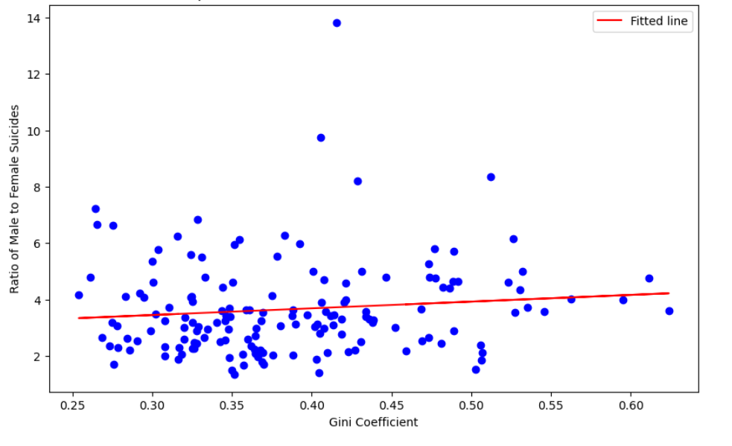
GINI COEFFICIENT VS MALE/FEMALE SUICIDE RATIO

Slide 27
INSIGHTS
The slope(2.3792) suggests a very small increase in the male to female suicide ratio with higher Gini coefficient values.
However, this relationship is not statistically significant, as indicated by the high p-value (0.1663), which is greater than the conventional threshold of 0.05.

Slide 28
GINI COEFFICIENT VS MALE/FEMALE SUICIDE RATIO

Slide 29
PREDICTIVE MODELING

Slide 30
DATA OVERVIEW AND DEFINING THE TARGET VARIABLE
Data Features: The dataset includes responses on depression levels, along with other mental health indicators and demographic information.
Variable Insight: The 'Problem_Depression' column was analyzed to understand its distribution across the surveyed population.
Target Definition: A new target variable, 'Mental_Health_Issue', was created based on depression levels, categorizing responses into binary outcomes (0 = low/no depression, 1 = moderate/high depression).

Slide 31
FEATURE SELECTION AND PREPROCESSING
Selected Features: Features include demographic details and a range of mental health issues like sleep problems, energy levels, appetite, self-doubt, and suicidal thoughts.
Preprocessing Steps: Data preprocessing involved handling categorical and numerical data using pipelines that include imputation for missing values and scaling.

Slide 32
RECOMMENDATIONS FOR ACTION
Enhanced Mental Health Services: Increase accessibility to mental health services across all demographics to mitigate suicide rates.
Policy Implementation: Advocate for policies that address economic disparities, potentially reducing stressors contributing to mental health issues.
Public Awareness Campaigns: Promote awareness and education on mental health to destigmatize seeking help.

Slide 33
FUTURE RESEARCH DIRECTIONS
Cross-Cultural Analyses: Further research into cultural factors influencing the methods and prevalence of suicide.
Impact of Digital Media: Explore how digital media consumption affects mental health across different age groups.

Slide 34
THANK YOU

Slide 35
QUESTIONS & ANSWERS

